Slide 1
CS3383 · WEEK 07 TUTORIAL
W07
Debugging Terminal Snake
01 Reproduce a failure and write a bug report
02 Use OpenCode to repair and test the fix
03 Track the fix through an Issue and a reviewed PR
Notes:
T01 | Debugging Terminal Snake
Source: Supplied W7 debugging and bug-report lecture slides; 2025 CS3343 BugReporting tutorial; executable Terminal Snake starter; official GitHub collaboration/Issue/review documentation. Local Java/Maven replay recorded; classroom OpenCode/dpsk and GUI screenshots pending.
Prior: W4–W6 tests, coverage, Git, refactoring, Plan/Build and code review
Next: One input moves one cell

Slide 2
TERMINAL SNAKE
The Terminal Snake Game
Action | Required behaviour
W / A / S / D + Enter | Move up / left / down / right by one cell
Eat food | Grow by one cell; add 10 points
Hit a wall or the body | End the round; never move outside the board
Move into the old tail cell | Legal when the tail moves away on this turn
R / Q | Restart with score 0 / quit
Reverse turns are ignored.
Enter alone continues in the current direction.
The game waits for input; it is not real-time.
Notes:
T05 | The rules we will test
Source: Supplied W7 debugging and bug-report lecture slides; 2025 CS3343 BugReporting tutorial; executable Terminal Snake starter; official GitHub collaboration/Issue/review documentation. Local Java/Maven replay recorded; classroom OpenCode/dpsk and GUI screenshots pending.
Prior: A wall should end the round
Next: Four starting positions, one game

Slide 3
TERMINAL SNAKE
Direction + Enter to move the snake
NORMAL: start
D + Enter
Then S + Enter
+--------+
|........|
|........|
|.ooH..*.|
|........|
|........|
|........|
+--------+
+--------+
|........|
|........|
|..ooH.*.|
|........|
|........|
|........|
+--------+
+--------+
|........|
|........|
|...oo.*.|
|....H...|
|........|
|........|
+--------+
Head (3,2) · length 3
Head (4,2) · right
Head (4,3) · down
One input moves one cell.
H = head; o = body; * = food; . = empty.
Notes:
T02 | One input moves one cell
Source: Supplied W7 debugging and bug-report lecture slides; 2025 CS3343 BugReporting tutorial; executable Terminal Snake starter; official GitHub collaboration/Issue/review documentation. Local Java/Maven replay recorded; classroom OpenCode/dpsk and GUI screenshots pending.
Prior: Debugging Terminal Snake
Next: Eating food grows the snake

Slide 4
TERMINAL SNAKE
Eating food grows the snake
NORMAL after D, D
One more D + Enter
+--------+
|........|
|........|
|...ooH*.|
|........|
|........|
|........|
+--------+
+--------+
|........|
|........|
|...oooH.|
|........|
|........|
|.*......|
+--------+
Head (5,2) · length 3 · score 0
Head (6,2) · length 4 · score 10
The next D + Enter eats the food. Length increases by one; score increases by 10. New food appears in a free cell.
Notes:
T03 | Eating food grows the snake
Source: Supplied W7 debugging and bug-report lecture slides; 2025 CS3343 BugReporting tutorial; executable Terminal Snake starter; official GitHub collaboration/Issue/review documentation. Local Java/Maven replay recorded; classroom OpenCode/dpsk and GUI screenshots pending.
Prior: One input moves one cell
Next: A wall should end the round

Slide 5
TERMINAL SNAKE
A wall should end the round
WALL after one D
Next D: end of game
+--------+
|*.......|
|........|
|.....ooH|
|........|
|........|
|........|
+--------+
+--------+
|*.......|
|........|
|.....ooH|
|........|
|........|
|........|
+--------+
RUNNING · last legal column x = 7
WALL · head remains at (7,2)
Required behaviour:
the next D + Enter ends the round with WALL. The head stays at (7,2).
Notes:
T04 | A wall should end the round
Source: Supplied W7 debugging and bug-report lecture slides; 2025 CS3343 BugReporting tutorial; executable Terminal Snake starter; official GitHub collaboration/Issue/review documentation. Local Java/Maven replay recorded; classroom OpenCode/dpsk and GUI screenshots pending.
Prior: Eating food grows the snake
Next: The rules we will test

Slide 6
TERMINAL SNAKE
Four scenarios with different starting positions
Menu choice | Purpose
1 NORMAL | Learn the controls and eating rule
2 WALL | Start near the right edge; inspect wall behaviour
3 LOOP | Classroom case: move into the departing tail
4 PICNIC | After-class case: eat food, then restart
These are starting positions, not different game modes. They use the same rules and controls.
Notes:
T06 | Four starting positions, one game
Source: Supplied W7 debugging and bug-report lecture slides; 2025 CS3343 BugReporting tutorial; executable Terminal Snake starter; official GitHub collaboration/Issue/review documentation. Local Java/Maven replay recorded; classroom OpenCode/dpsk and GUI screenshots pending.
Prior: The rules we will test
Next: The supplied Java project

Slide 7
GETTING STARTED
The supplied Java project
Extract CS3383_Week07_Tutorial_Code.zip. VS Code → File → Open Folder → terminal-snake. Copy your working opencode.json into this root.
File | Role
TerminalSnake.java | Terminal input, board display and replay
SnakeGame.java | Movement, collision, food, score and restart
Scenario.java | Four reproducible starting positions
SnakeGameTest.java | 6 passing baseline tests
pom.xml | Supplied JUnit, JaCoCo settings
Notes:
T07 | The supplied Java project
Source: Supplied W7 debugging and bug-report lecture slides; 2025 CS3343 BugReporting tutorial; executable Terminal Snake starter; official GitHub collaboration/Issue/review documentation. Local Java/Maven replay recorded; classroom OpenCode/dpsk and GUI screenshots pending.
Prior: Four starting positions, one game
Next: OpenCode: plan before editing

Slide 8
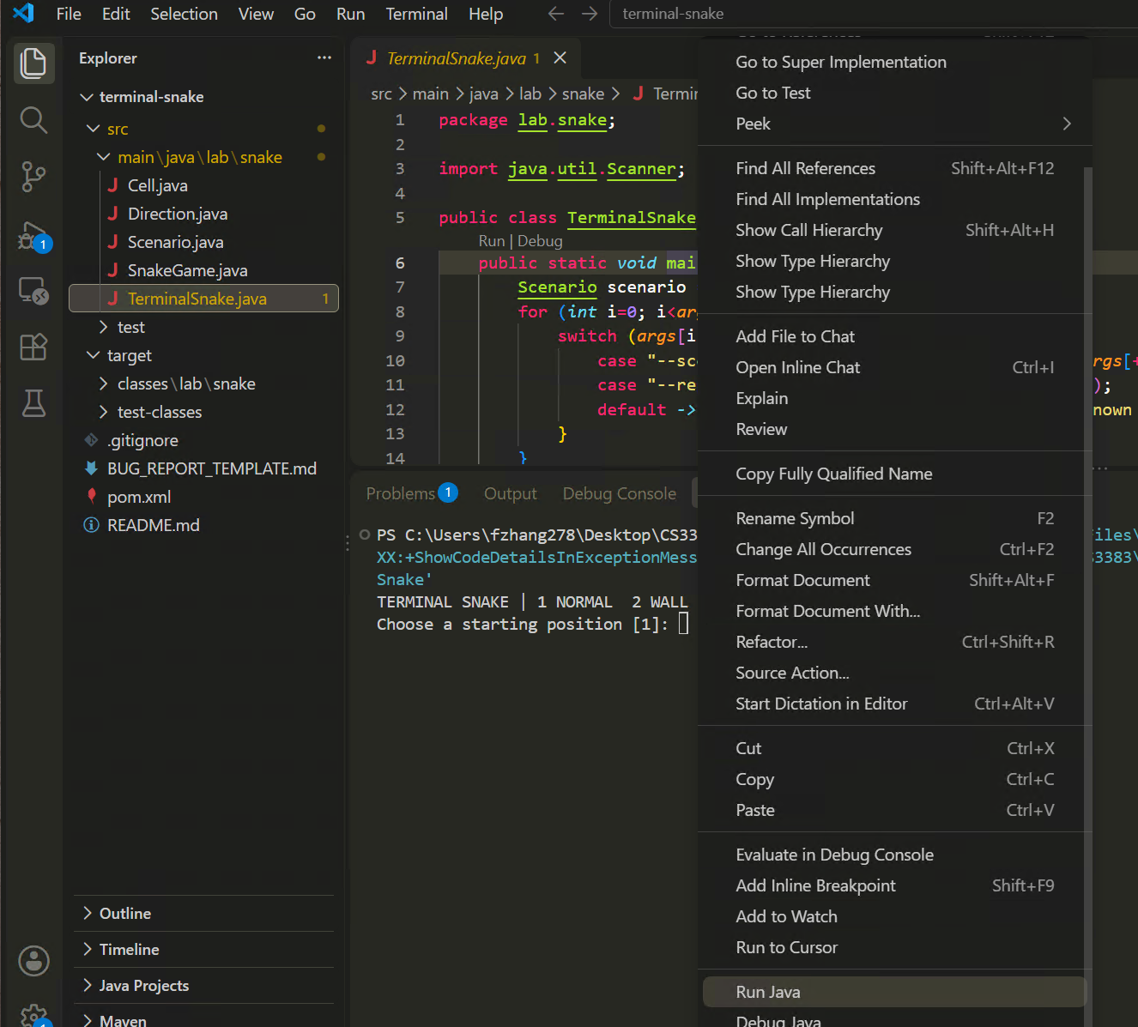
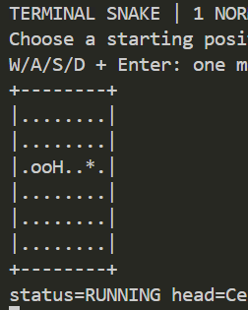
PLAY THE STARTER
Run and play Snake
Open TerminalSnake.java → right-click on main → Run Java.
Choose 1 for NORMAL. Enter one direction at a time, followed by Enter. Try food, turns and walls. R restarts; Q exits.
Notes:
T09 | Run and play Snake
Source: Supplied W7 debugging and bug-report lecture slides; 2025 CS3343 BugReporting tutorial; executable Terminal Snake starter; official GitHub collaboration/Issue/review documentation. Local Java/Maven replay recorded; classroom OpenCode/dpsk and GUI screenshots pending.
Prior: OpenCode: plan before editing
Next: Record the starting test result
[CAPTURE NEEDED]
Product/build: Record actual classroom VS Code Java extension, GitHub web UI and OpenCode/dpsk versions.
Starting state: Follow preceding pages on the specified branch and account.
Exact action already completed: Open src/main/java/lab/snake/TerminalSnake.java → Run above main. The supplied settings use the integrated terminal. Choose 1 for NORMAL. Enter one direction at a time, followed by Enter. Try food, turns and walls. R restarts; Q exits. If Run is missing, wait for Java project import. Use Run and Debug → Play Snake if the terminal does not accept input.
Required visible region/text: Terminal board, chosen scenario, controls and state summary
Callouts to add: File/path, active branch/account role, named control and decisive result.
Data to redact: Credentials, keys, endpoints, personal usernames/email and unnecessary local paths. Keep the student account and current branch identifiable without exposing personal data.

Slide 9
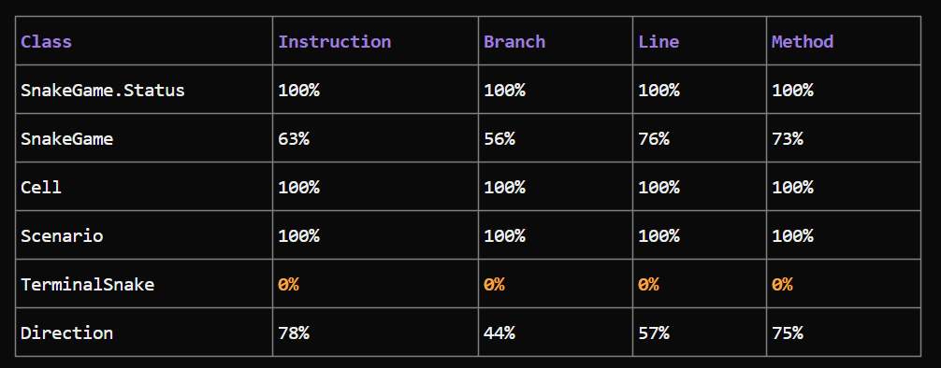
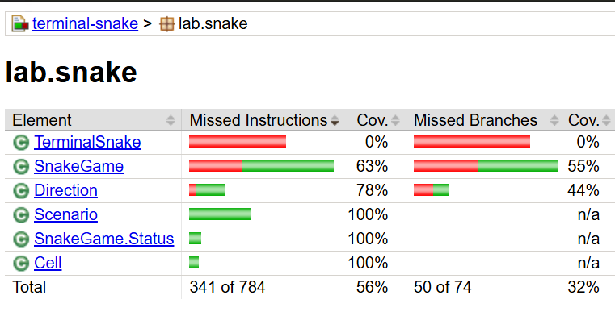
BASELINE
Record the starting test result
Copy this prompt to OpenCode in Build Mode
Run tests and generate the JaCoCo report. Summarize the test results and coverage. Do not edit files.
Notes:
T10 | Record the starting test result
Source: Supplied W7 debugging and bug-report lecture slides; 2025 CS3343 BugReporting tutorial; executable Terminal Snake starter; official GitHub collaboration/Issue/review documentation. Local Java/Maven replay recorded; classroom OpenCode/dpsk and GUI screenshots pending.
Prior: Run and play Snake
Next: Publish your repository
[CAPTURE NEEDED]
Product/build: Record actual classroom VS Code Java extension, GitHub web UI and OpenCode/dpsk versions.
Starting state: Follow preceding pages on the specified branch and account.
Exact action already completed: Build Mode. Expect 6 tests, no failures or errors. Passing tests cover only some game rules. Keep this result for comparison. JaCoCo is the Java coverage tool; its HTML report is target/site/jacoco/index.html. If the suite fails, repair the W6 setup first.
Required visible region/text: 6-test baseline and JaCoCo line/branch coverage
Callouts to add: File/path, active branch/account role, named control and decisive result.
Data to redact: Credentials, keys, endpoints, personal usernames/email and unnecessary local paths. Keep the student account and current branch identifiable without exposing personal data.

Slide 10
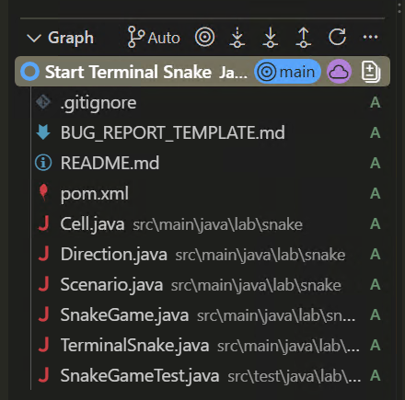
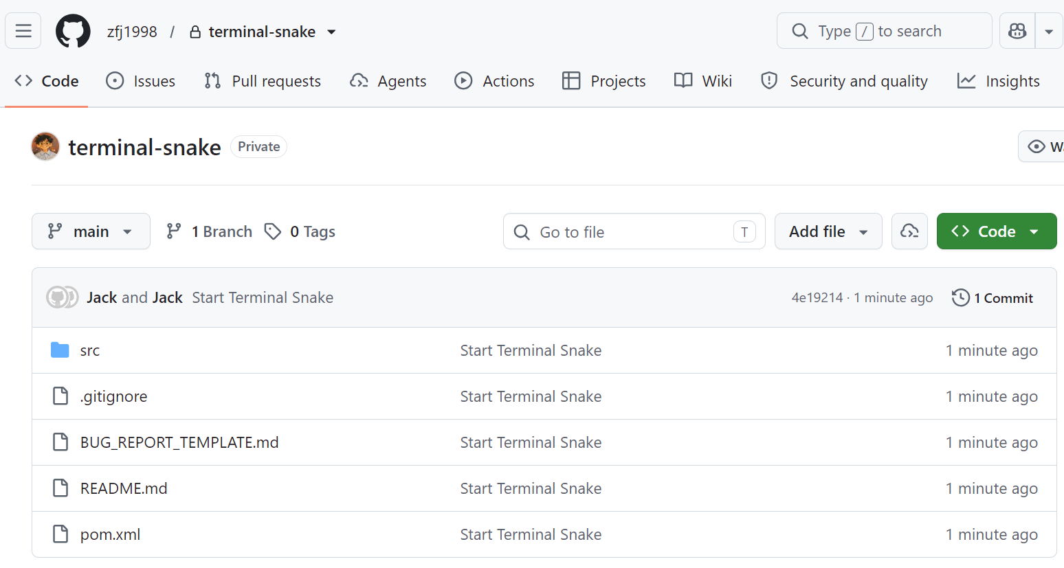
TEAM SETUP
Publish your repository
In your VS Code project folder: Source Control → Initialize Repository → stage files with + → Commit “Start Terminal Snake”. Rename the branch to main if needed.
Publish Branch → terminal-snake. Sign in if asked. Confirm opencode.json and target/ are absent from Changes.
If Git identity is missing, ask OpenCode in Build: set this repo’s author to {your_name} and {your_email}; then retry the commit.
Notes:
T11 | Publish your repository
Source: Supplied W7 debugging and bug-report lecture slides; 2025 CS3343 BugReporting tutorial; executable Terminal Snake starter; official GitHub collaboration/Issue/review documentation. Local Java/Maven replay recorded; classroom OpenCode/dpsk and GUI screenshots pending.
Prior: Record the starting test result
Next: Invite your collaborator
[CAPTURE NEEDED]
Product/build: Record actual classroom VS Code Java extension, GitHub web UI and OpenCode/dpsk versions.
Starting state: Follow preceding pages on the specified branch and account.
Exact action already completed: In your VS Code project folder: Source Control → Initialize Repository → stage files with + → Commit “Start Terminal Snake”. Rename the branch to main if needed. Ctrl+Shift+P → Publish to GitHub → cs3383-w07-snake. Sign in if asked. Confirm opencode.json and target/ are absent from Changes. If Git identity is missing, ask OpenCode in Build: set this repo’s author to your actual name and email; then retry the commit.
Required visible region/text: Owner main branch, initial commit and published repository
Callouts to add: File/path, active branch/account role, named control and decisive result.
Data to redact: Credentials, keys, endpoints, personal usernames/email and unnecessary local paths. Keep the student account and current branch identifiable without exposing personal data.

Slide 11
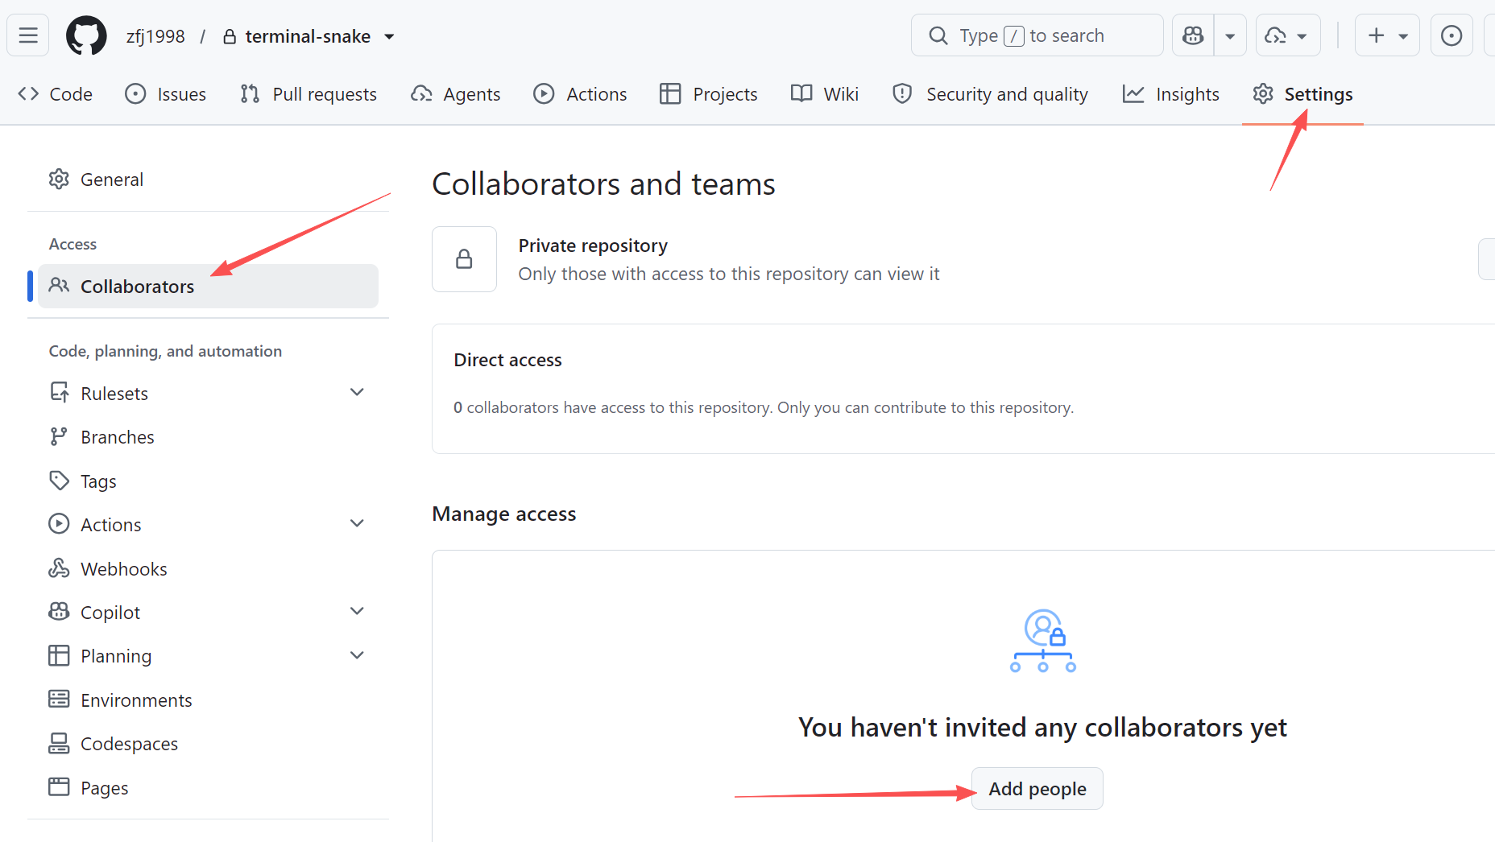
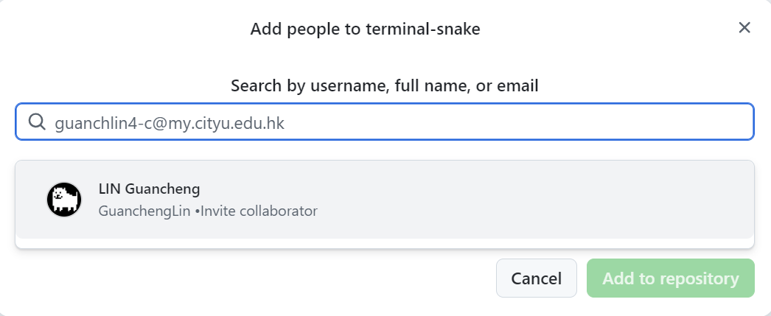
TEAM SETUP
Invite your collaborator
Owner: GitHub repository → Settings → Collaborators under Access → Add people. Search your partner’s actual GitHub username → Add to this repository.
Notes:
T12 | Invite your collaborator
Source: Supplied W7 debugging and bug-report lecture slides; 2025 CS3343 BugReporting tutorial; executable Terminal Snake starter; official GitHub collaboration/Issue/review documentation. Local Java/Maven replay recorded; classroom OpenCode/dpsk and GUI screenshots pending.
Prior: Publish your repository
Next: LOOP: the tail moves away
[CAPTURE NEEDED]
Product/build: Record actual classroom VS Code Java extension, GitHub web UI and OpenCode/dpsk versions.
Starting state: Follow preceding pages on the specified branch and account.
Exact action already completed: Owner: GitHub repository → Settings → Collaborators under Access → Add people. Search your partner’s actual GitHub username → select it → Add to this repository. Partner: open the GitHub invitation email or invitation link and accept. Owner checks that access is active, not pending. Do not share accounts. A mention alone does not grant access. Resolve a pending invitation before assigning work.
Required visible region/text: Invitation dialog and accepted collaborator access
Callouts to add: File/path, active branch/account role, named control and decisive result.
Data to redact: Credentials, keys, endpoints, personal usernames/email and unnecessary local paths. Keep the student account and current branch identifiable without exposing personal data.

Slide 12
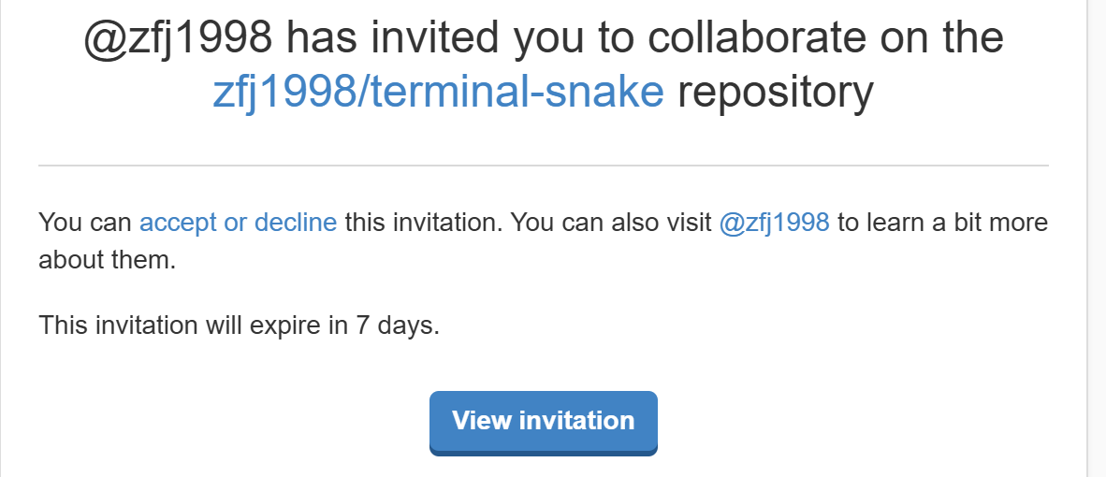
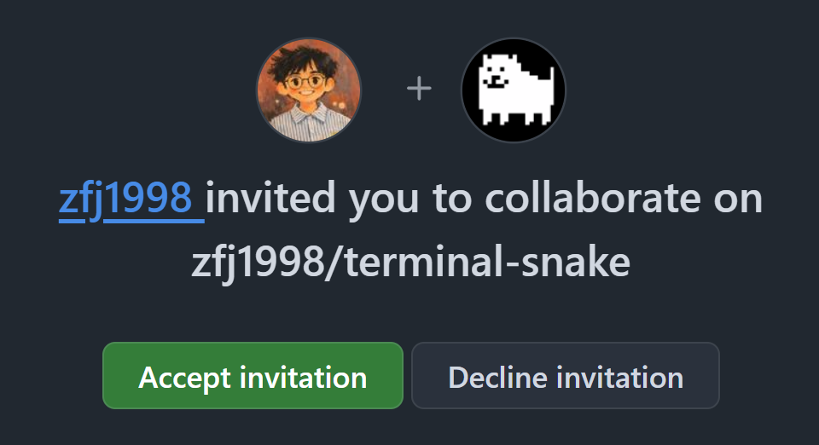
TEAM SETUP
Invite your collaborator
Partner: open the GitHub invitation email or invitation link and accept. Owner checks that access is active, not pending.
Notes:
T12 | Invite your collaborator
Source: Supplied W7 debugging and bug-report lecture slides; 2025 CS3343 BugReporting tutorial; executable Terminal Snake starter; official GitHub collaboration/Issue/review documentation. Local Java/Maven replay recorded; classroom OpenCode/dpsk and GUI screenshots pending.
Prior: Publish your repository
Next: LOOP: the tail moves away
[CAPTURE NEEDED]
Product/build: Record actual classroom VS Code Java extension, GitHub web UI and OpenCode/dpsk versions.
Starting state: Follow preceding pages on the specified branch and account.
Exact action already completed: Owner: GitHub repository → Settings → Collaborators under Access → Add people. Search your partner’s actual GitHub username → select it → Add to this repository. Partner: open the GitHub invitation email or invitation link and accept. Owner checks that access is active, not pending. Do not share accounts. A mention alone does not grant access. Resolve a pending invitation before assigning work.
Required visible region/text: Invitation dialog and accepted collaborator access
Callouts to add: File/path, active branch/account role, named control and decisive result.
Data to redact: Credentials, keys, endpoints, personal usernames/email and unnecessary local paths. Keep the student account and current branch identifiable without exposing personal data.

Slide 13
REPRODUCE A BUG
Reproduce a bug in the LOOP setting
Observe the LOOP failure: the snake has strange moves.
+--------+
|........|
|........|
|.oH.....|
|.oo.....|
|......*.|
|........|
+--------+
+--------+
|........|
|........|
|..oH....|
|.oo.....|
|......*.|
|........|
+--------+
+--------+
|........|
|........|
|..ooH...|
|..o.....|
|......*.|
|........|
+--------+
+--------+
|........|
|........|
|..oooH..|
|........|
|......*.|
|........|
+--------+
Start from
Head (2,2) · tail (1,2)
D + Enter
D + Enter
D + Enter
Notes:
T13 | LOOP: the tail moves away
Source: Supplied W7 debugging and bug-report lecture slides; 2025 CS3343 BugReporting tutorial; executable Terminal Snake starter; official GitHub collaboration/Issue/review documentation. Local Java/Maven replay recorded; classroom OpenCode/dpsk and GUI screenshots pending.
Prior: Invite your collaborator
Next: Observe the LOOP failure

Slide 14
REPRODUCE A BUG
Reproduce the bug with OpenCode
Copy this prompt to OpenCode in Plan Mode
There is a bug with the LOOP starting position. From a fresh LOOP start, after a move to the right, the snake looks like
###
oH
oo
###
However, it is supposed to be
###
ooH
o
###
Can you identify the bug here?
Notes:
T15 | Find the smallest reproduction
Source: Supplied W7 debugging and bug-report lecture slides; 2025 CS3343 BugReporting tutorial; executable Terminal Snake starter; official GitHub collaboration/Issue/review documentation. Local Java/Maven replay recorded; classroom OpenCode/dpsk and GUI screenshots pending.
Prior: Observe the LOOP failure
Next: Recorded reproduction results
[CAPTURE NEEDED]
Product/build: Record actual classroom VS Code Java extension, GitHub web UI and OpenCode/dpsk versions.
Starting state: Follow preceding pages on the specified branch and account.
Exact action already completed: Plan Mode can run read-only experiments. Check the executed replay output. Repeat from a fresh LOOP start. Expected: RUNNING at (1,2); actual: SELF at (2,2).
Required visible region/text: Executed LOOP A replay and repeated observations
Callouts to add: File/path, active branch/account role, named control and decisive result.
Data to redact: Credentials, keys, endpoints, personal usernames/email and unnecessary local paths. Keep the student account and current branch identifiable without exposing personal data.

Slide 15
BUG REPORT
Bug-report fields
Field | What to record
Title / description | Name the failure; describe the broken behaviour
Situation | Product, component, platform, OS and affected version
Severity | Impact: minor, normal, major or critical
Steps to reproduce (STR) | Starting position and exact ordered inputs
Expected result / Actual result | Required rule versus observed state; attach evidence
Notes:
T17 | Use the lecture bug-report fields
Source: Supplied W7 debugging and bug-report lecture slides; 2025 CS3343 BugReporting tutorial; executable Terminal Snake starter; official GitHub collaboration/Issue/review documentation. Local Java/Maven replay recorded; classroom OpenCode/dpsk and GUI screenshots pending.
Prior: Recorded reproduction results
Next: Draft the report from evidence

Slide 16
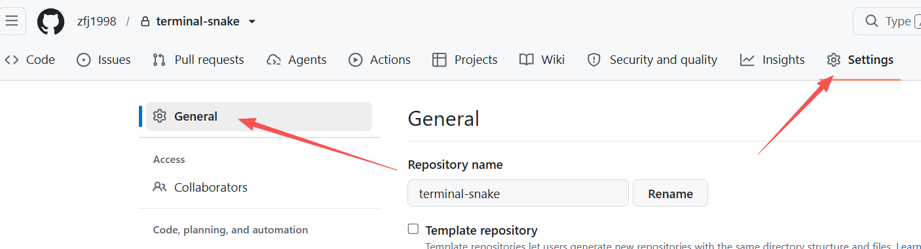
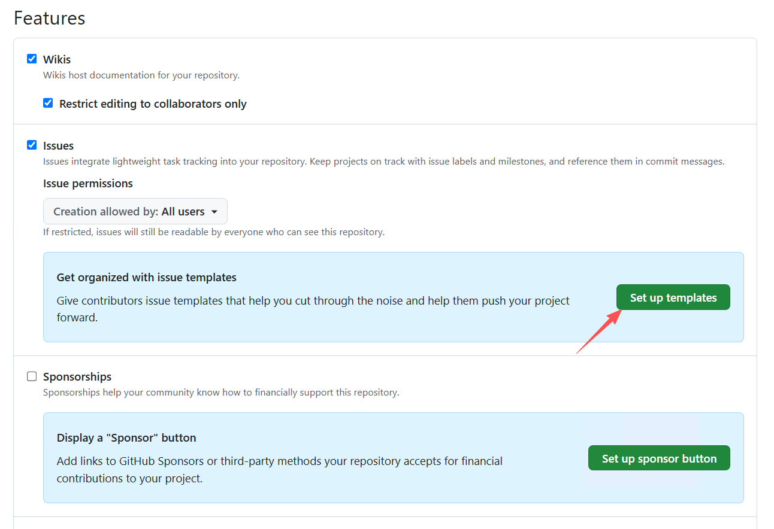
BUG REPORT
Set up a Bug report template in GitHub
Github Repository → Settings → General → Features → Issues →
Set up templates.
Notes:
T20 | Set up a Bug report template
Source: Supplied W7 debugging and bug-report lecture slides; 2025 CS3343 BugReporting tutorial; executable Terminal Snake starter; official GitHub collaboration/Issue/review documentation. Local Java/Maven replay recorded; classroom OpenCode/dpsk and GUI screenshots pending.
Prior: Example bug report
Next: Create and assign a GitHub Issue
[CAPTURE NEEDED]
Product/build: Record actual classroom VS Code Java extension, GitHub web UI and OpenCode/dpsk versions.
Starting state: Follow preceding pages on the specified branch and account.
Exact action already completed: Repository → Settings → General → Features → Issues → Set up templates. Add template → Bug report → Preview and edit → pencil. Keep the name Bug report. Replace its body with the supplied BUG_REPORT_TEMPLATE.md, using the lecture fields just shown. Propose changes → commit to main → Commit changes. Check Issues → New issue lists Bug report. In VS Code on main, Source Control … → Pull to receive the template commit.
Required visible region/text: GitHub template editor with lecture fields; Bug report available for a new Issue
Callouts to add: File/path, active branch/account role, named control and decisive result.
Data to redact: Credentials, keys, endpoints, personal usernames/email and unnecessary local paths. Keep the student account and current branch identifiable without exposing personal data.

Slide 17
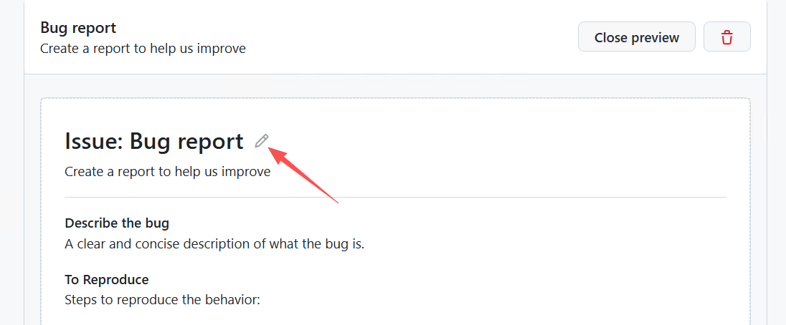
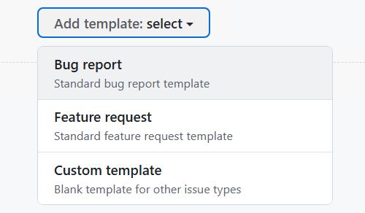
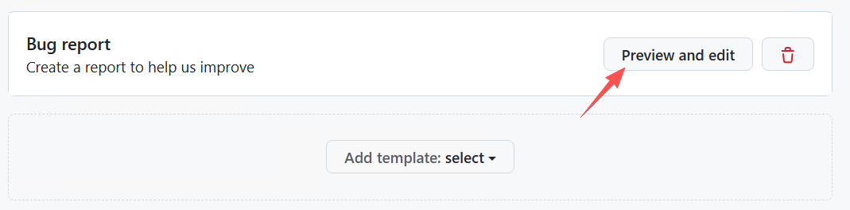
BUG REPORT
Set up a Bug report template in GitHub
Add template → Bug report → Preview and edit → pencil.
Refresh the web page if it does not respond when choosing `Bug Report`
Notes:
T20 | Set up a Bug report template
Source: Supplied W7 debugging and bug-report lecture slides; 2025 CS3343 BugReporting tutorial; executable Terminal Snake starter; official GitHub collaboration/Issue/review documentation. Local Java/Maven replay recorded; classroom OpenCode/dpsk and GUI screenshots pending.
Prior: Example bug report
Next: Create and assign a GitHub Issue
[CAPTURE NEEDED]
Product/build: Record actual classroom VS Code Java extension, GitHub web UI and OpenCode/dpsk versions.
Starting state: Follow preceding pages on the specified branch and account.
Exact action already completed: Repository → Settings → General → Features → Issues → Set up templates. Add template → Bug report → Preview and edit → pencil. Keep the name Bug report. Replace its body with the supplied BUG_REPORT_TEMPLATE.md, using the lecture fields just shown. Propose changes → commit to main → Commit changes. Check Issues → New issue lists Bug report. In VS Code on main, Source Control … → Pull to receive the template commit.
Required visible region/text: GitHub template editor with lecture fields; Bug report available for a new Issue
Callouts to add: File/path, active branch/account role, named control and decisive result.
Data to redact: Credentials, keys, endpoints, personal usernames/email and unnecessary local paths. Keep the student account and current branch identifiable without exposing personal data.

Slide 18
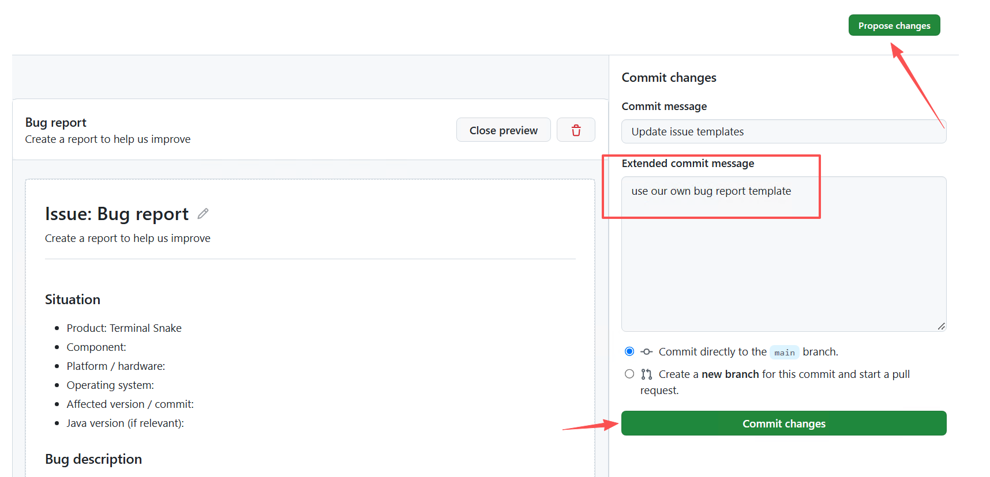
BUG REPORT
Set up a Bug report template in GitHub
Keep the name Bug report. Replace its body with the supplied BUG_REPORT_TEMPLATE.md.
Propose changes → Commit message “use our own bug report template” → commit to main → Commit changes.
Notes:
T20 | Set up a Bug report template
Source: Supplied W7 debugging and bug-report lecture slides; 2025 CS3343 BugReporting tutorial; executable Terminal Snake starter; official GitHub collaboration/Issue/review documentation. Local Java/Maven replay recorded; classroom OpenCode/dpsk and GUI screenshots pending.
Prior: Example bug report
Next: Create and assign a GitHub Issue
[CAPTURE NEEDED]
Product/build: Record actual classroom VS Code Java extension, GitHub web UI and OpenCode/dpsk versions.
Starting state: Follow preceding pages on the specified branch and account.
Exact action already completed: Repository → Settings → General → Features → Issues → Set up templates. Add template → Bug report → Preview and edit → pencil. Keep the name Bug report. Replace its body with the supplied BUG_REPORT_TEMPLATE.md, using the lecture fields just shown. Propose changes → commit to main → Commit changes. Check Issues → New issue lists Bug report. In VS Code on main, Source Control … → Pull to receive the template commit.
Required visible region/text: GitHub template editor with lecture fields; Bug report available for a new Issue
Callouts to add: File/path, active branch/account role, named control and decisive result.
Data to redact: Credentials, keys, endpoints, personal usernames/email and unnecessary local paths. Keep the student account and current branch identifiable without exposing personal data.

Slide 19
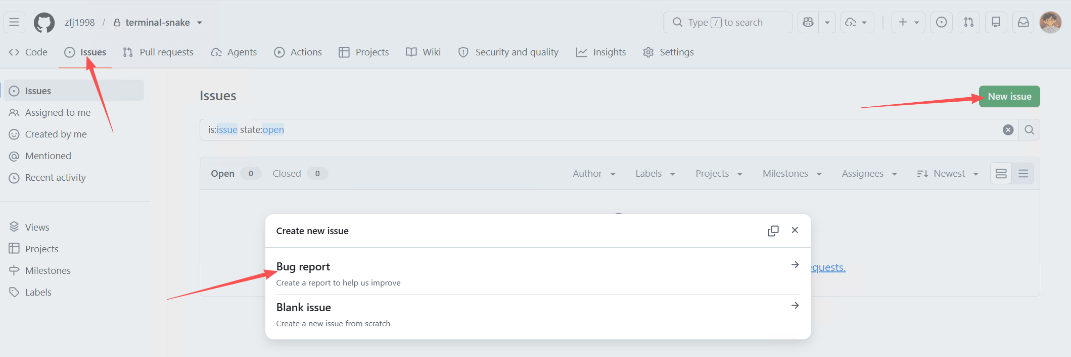
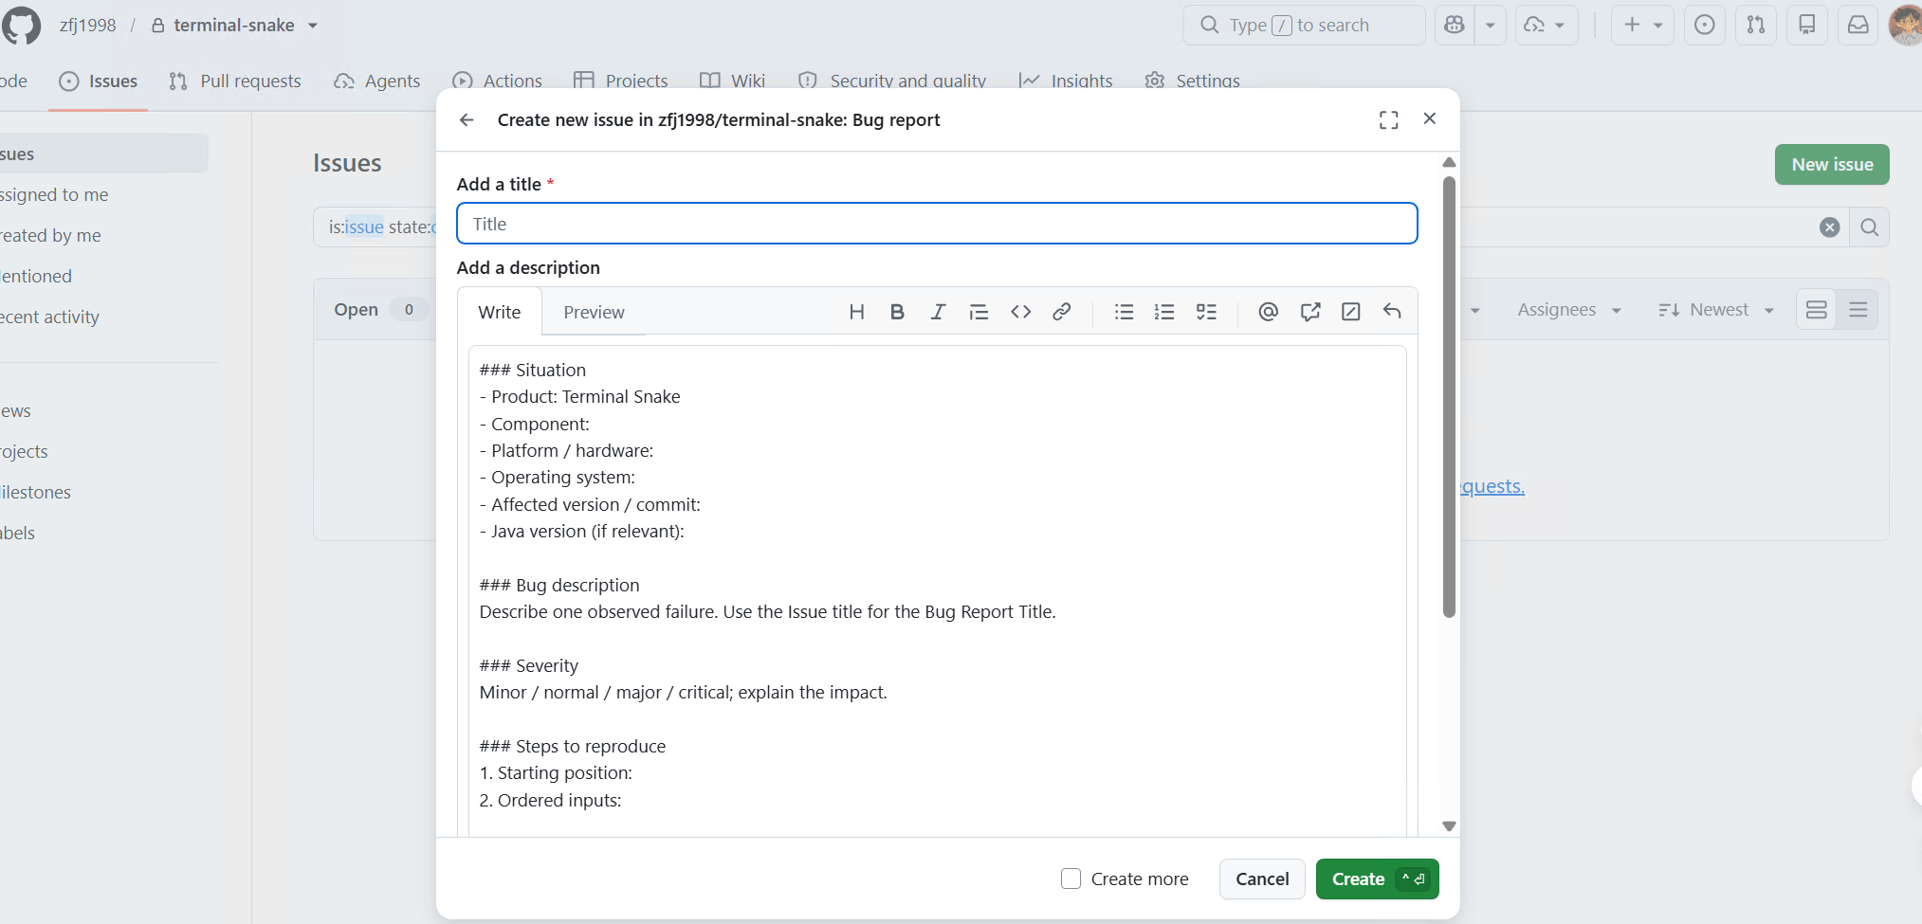
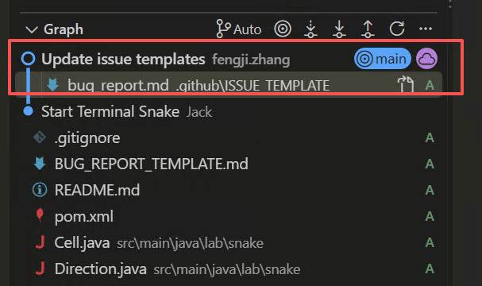
BUG REPORT
Set up a Bug report template in GitHub
Check Issues → New issue lists Bug report.
In VS Code on main, Source Control … → Pull to receive the template commit.
Notes:
T20 | Set up a Bug report template
Source: Supplied W7 debugging and bug-report lecture slides; 2025 CS3343 BugReporting tutorial; executable Terminal Snake starter; official GitHub collaboration/Issue/review documentation. Local Java/Maven replay recorded; classroom OpenCode/dpsk and GUI screenshots pending.
Prior: Example bug report
Next: Create and assign a GitHub Issue
[CAPTURE NEEDED]
Product/build: Record actual classroom VS Code Java extension, GitHub web UI and OpenCode/dpsk versions.
Starting state: Follow preceding pages on the specified branch and account.
Exact action already completed: Repository → Settings → General → Features → Issues → Set up templates. Add template → Bug report → Preview and edit → pencil. Keep the name Bug report. Replace its body with the supplied BUG_REPORT_TEMPLATE.md, using the lecture fields just shown. Propose changes → commit to main → Commit changes. Check Issues → New issue lists Bug report. In VS Code on main, Source Control … → Pull to receive the template commit.
Required visible region/text: GitHub template editor with lecture fields; Bug report available for a new Issue
Callouts to add: File/path, active branch/account role, named control and decisive result.
Data to redact: Credentials, keys, endpoints, personal usernames/email and unnecessary local paths. Keep the student account and current branch identifiable without exposing personal data.

Slide 20
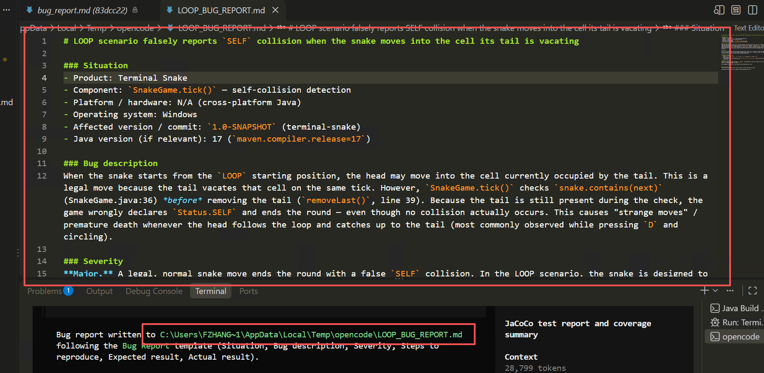
BUG REPORT
Draft the Bug Report with OpenCode
Copy this prompt to OpenCode in Build Mode
Draft the LOOP bug report with the `Bug Report` template to a temporary markdown file.
Notes:
T18 | Draft the report from evidence
Source: Supplied W7 debugging and bug-report lecture slides; 2025 CS3343 BugReporting tutorial; executable Terminal Snake starter; official GitHub collaboration/Issue/review documentation. Local Java/Maven replay recorded; classroom OpenCode/dpsk and GUI screenshots pending.
Prior: Use the lecture bug-report fields
Next: Example bug report
[CAPTURE NEEDED]
Product/build: Record actual classroom VS Code Java extension, GitHub web UI and OpenCode/dpsk versions.
Starting state: Follow preceding pages on the specified branch and account.
Exact action already completed: Situation includes the actual product, component, platform, OS and affected commit. Add JDK version if relevant. Check every claim against your replay. Fill unknown environment details yourself.
Required visible region/text: Lecture-aligned report with actual observations
Callouts to add: File/path, active branch/account role, named control and decisive result.
Data to redact: Credentials, keys, endpoints, personal usernames/email and unnecessary local paths. Keep the student account and current branch identifiable without exposing personal data.

Slide 21
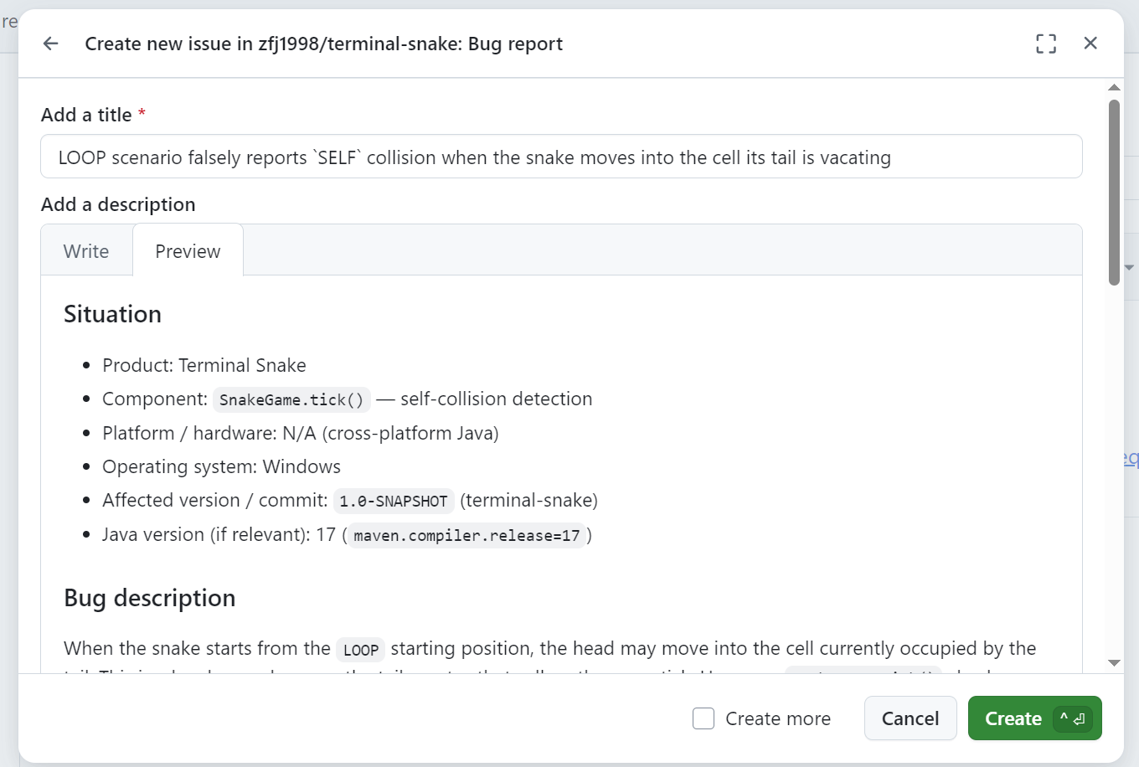
TRACK THE BUG
Create a GitHub Issue (copy-paste)
GitHub → Issues → New issue → Bug report → Get started.
Fill the checked title and report → Create.
Notes:
T21 | Create and assign a GitHub Issue
Source: Supplied W7 debugging and bug-report lecture slides; 2025 CS3343 BugReporting tutorial; executable Terminal Snake starter; official GitHub collaboration/Issue/review documentation. Local Java/Maven replay recorded; classroom OpenCode/dpsk and GUI screenshots pending.
Prior: Set up a Bug report template
Next: Start a fix branch for this Issue
[CAPTURE NEEDED]
Product/build: Record actual classroom VS Code Java extension, GitHub web UI and OpenCode/dpsk versions.
Starting state: Follow preceding pages on the specified branch and account.
Exact action already completed: GitHub → Issues → New issue → Bug report → Get started. Fill the checked title and report → Create. Note its actual Issue number. Use Assignees to choose yourself as fixer. Add a comment: “@PARTNER please check the LOOP A reproduction on this commit.” Replace PARTNER with the real handle. An assignee owns the work; @mention requests attention. A mention does not assign the Issue. Use one Issue for this failure.
Required visible region/text: Issue report, assigned fixer and collaborator @mention
Callouts to add: File/path, active branch/account role, named control and decisive result.
Data to redact: Credentials, keys, endpoints, personal usernames/email and unnecessary local paths. Keep the student account and current branch identifiable without exposing personal data.

Slide 22
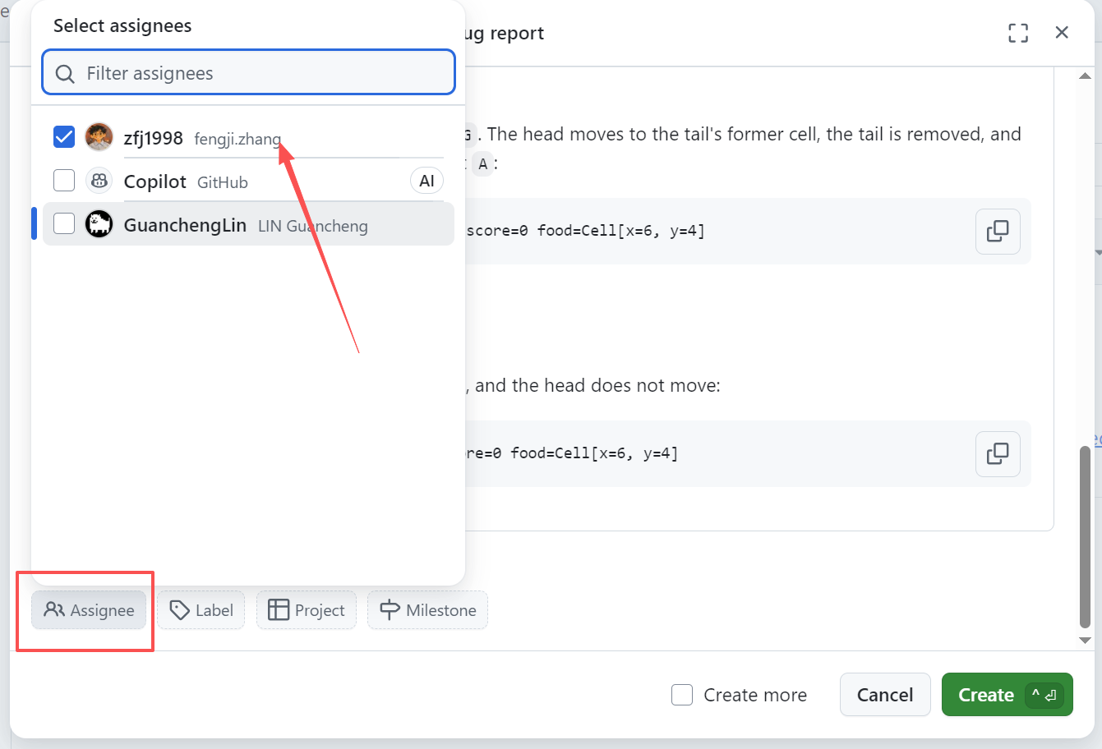
TRACK THE BUG
Create and assign a GitHub Issue
Use Assignees to choose yourself as fixer. Add a comment: “@PARTNER please check the LOOP A reproduction on this commit.” Replace PARTNER with the real handle.
Notes:
T21 | Create and assign a GitHub Issue
Source: Supplied W7 debugging and bug-report lecture slides; 2025 CS3343 BugReporting tutorial; executable Terminal Snake starter; official GitHub collaboration/Issue/review documentation. Local Java/Maven replay recorded; classroom OpenCode/dpsk and GUI screenshots pending.
Prior: Set up a Bug report template
Next: Start a fix branch for this Issue
[CAPTURE NEEDED]
Product/build: Record actual classroom VS Code Java extension, GitHub web UI and OpenCode/dpsk versions.
Starting state: Follow preceding pages on the specified branch and account.
Exact action already completed: GitHub → Issues → New issue → Bug report → Get started. Fill the checked title and report → Create. Note its actual Issue number. Use Assignees to choose yourself as fixer. Add a comment: “@PARTNER please check the LOOP A reproduction on this commit.” Replace PARTNER with the real handle. An assignee owns the work; @mention requests attention. A mention does not assign the Issue. Use one Issue for this failure.
Required visible region/text: Issue report, assigned fixer and collaborator @mention
Callouts to add: File/path, active branch/account role, named control and decisive result.
Data to redact: Credentials, keys, endpoints, personal usernames/email and unnecessary local paths. Keep the student account and current branch identifiable without exposing personal data.

Slide 23
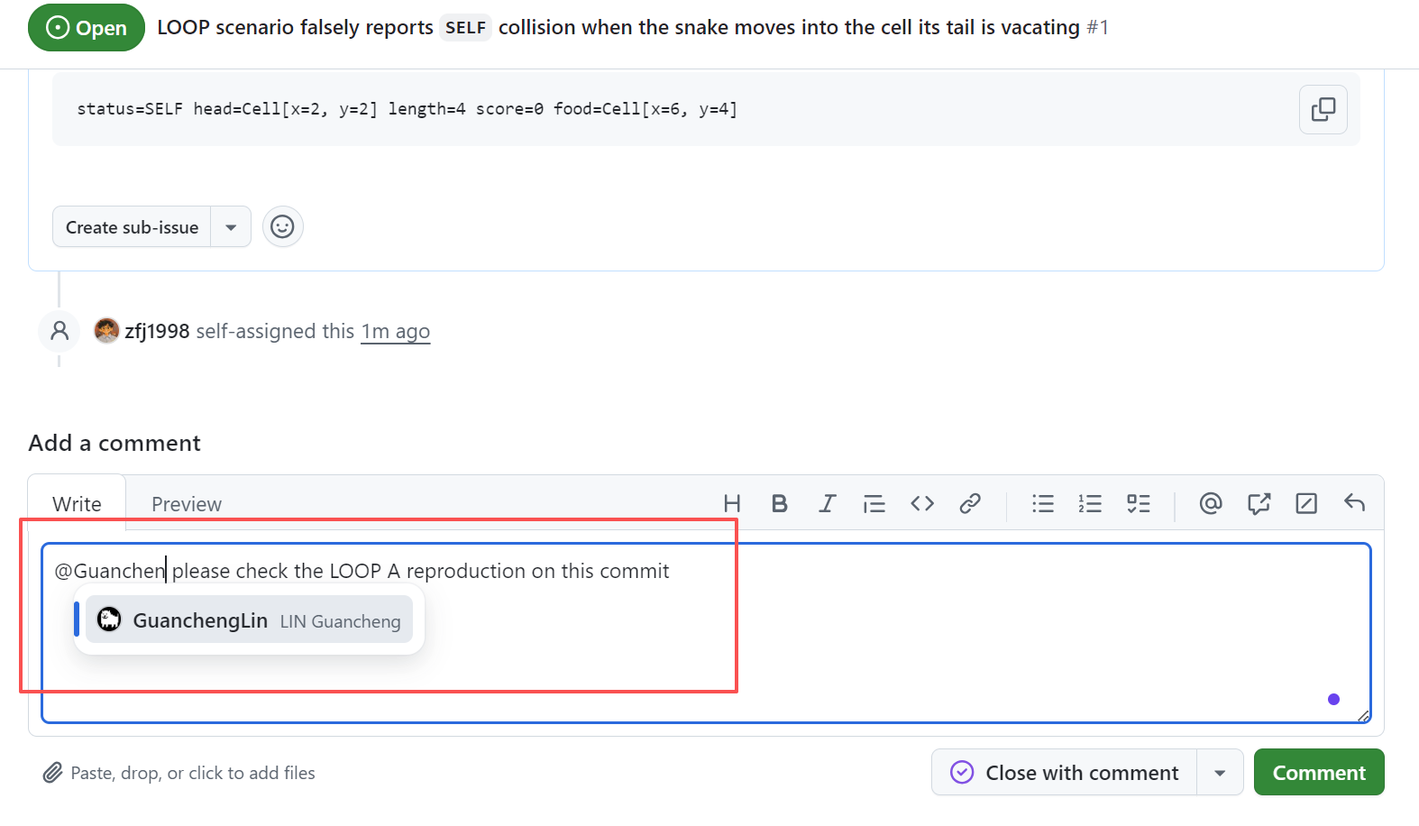
TRACK THE BUG
Create and assign a GitHub Issue
Use Assignees to choose yourself as fixer. Add a comment: “@PARTNER please check the LOOP A reproduction on this commit.” Replace PARTNER with the real handle.
Notes:
T21 | Create and assign a GitHub Issue
Source: Supplied W7 debugging and bug-report lecture slides; 2025 CS3343 BugReporting tutorial; executable Terminal Snake starter; official GitHub collaboration/Issue/review documentation. Local Java/Maven replay recorded; classroom OpenCode/dpsk and GUI screenshots pending.
Prior: Set up a Bug report template
Next: Start a fix branch for this Issue
[CAPTURE NEEDED]
Product/build: Record actual classroom VS Code Java extension, GitHub web UI and OpenCode/dpsk versions.
Starting state: Follow preceding pages on the specified branch and account.
Exact action already completed: GitHub → Issues → New issue → Bug report → Get started. Fill the checked title and report → Create. Note its actual Issue number. Use Assignees to choose yourself as fixer. Add a comment: “@PARTNER please check the LOOP A reproduction on this commit.” Replace PARTNER with the real handle. An assignee owns the work; @mention requests attention. A mention does not assign the Issue. Use one Issue for this failure.
Required visible region/text: Issue report, assigned fixer and collaborator @mention
Callouts to add: File/path, active branch/account role, named control and decisive result.
Data to redact: Credentials, keys, endpoints, personal usernames/email and unnecessary local paths. Keep the student account and current branch identifiable without exposing personal data.

Slide 24

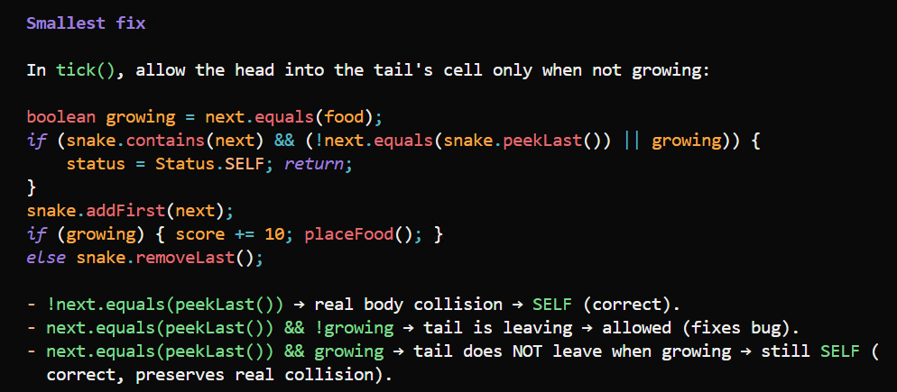
DEBUG THE CAUSE
Start a fix branch for this Issue
Fixer: VS Code → main in the Status Bar → Create new branch → fix/tail-collision. Confirm the active branch and clean Source Control.
Plan a small repair
Copy this prompt to OpenCode in Plan Mode
Plan the smallest fix for the LOOP bug. Please also propose regression cases.
Notes:
T22 | Start a fix branch for this Issue
Source: Supplied W7 debugging and bug-report lecture slides; 2025 CS3343 BugReporting tutorial; executable Terminal Snake starter; official GitHub collaboration/Issue/review documentation. Local Java/Maven replay recorded; classroom OpenCode/dpsk and GUI screenshots pending.
Prior: Create and assign a GitHub Issue
Next: Trace the rejected move
[CAPTURE NEEDED]
Product/build: Record actual classroom VS Code Java extension, GitHub web UI and OpenCode/dpsk versions.
Starting state: Follow preceding pages on the specified branch and account.
Exact action already completed: Fixer: VS Code → main in the Status Bar → Create new branch → fix/tail-collision. Confirm the active branch and clean Source Control. Keep the same OpenCode conversation with the reproduction. Use Plan Mode. Work on this Issue only; do not fix every defect yet. main remains the affected baseline until the reviewed fix is merged.
Required visible region/text: fix/tail-collision branch and retained reproduction evidence
Callouts to add: File/path, active branch/account role, named control and decisive result.
Data to redact: Credentials, keys, endpoints, personal usernames/email and unnecessary local paths. Keep the student account and current branch identifiable without exposing personal data.

Slide 25
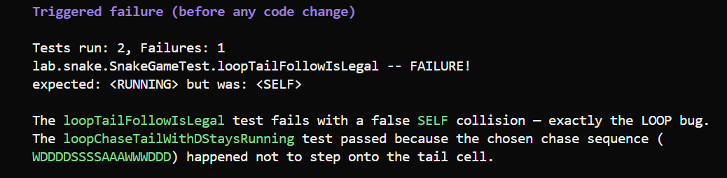
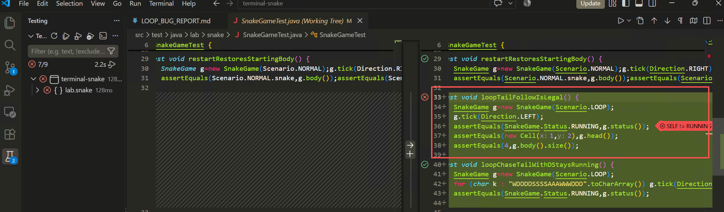
REGRESSION TEST
Add the failing regression test first
Copy this prompt to OpenCode in Build Mode
Add tests for the LOOP bug. Run the tests before changing any code; show the added tests and the triggered failure.
Notes:
T27 | Add the failing regression test first
Source: Supplied W7 debugging and bug-report lecture slides; 2025 CS3343 BugReporting tutorial; executable Terminal Snake starter; official GitHub collaboration/Issue/review documentation. Local Java/Maven replay recorded; classroom OpenCode/dpsk and GUI screenshots pending.
Prior: Plan a small repair
Next: Fix the cause and rerun tests
[CAPTURE NEEDED]
Product/build: Record actual classroom VS Code Java extension, GitHub web UI and OpenCode/dpsk versions.
Starting state: Follow preceding pages on the specified branch and account.
Exact action already completed: Switch to Build Mode. At this step, only test code should change. The new test should fail with SELF. If it passes, inspect its setup and assertions before editing the source.
Required visible region/text: New test fails with SELF; original 6 tests preserved
Callouts to add: File/path, active branch/account role, named control and decisive result.
Data to redact: Credentials, keys, endpoints, personal usernames/email and unnecessary local paths. Keep the student account and current branch identifiable without exposing personal data.

Slide 26
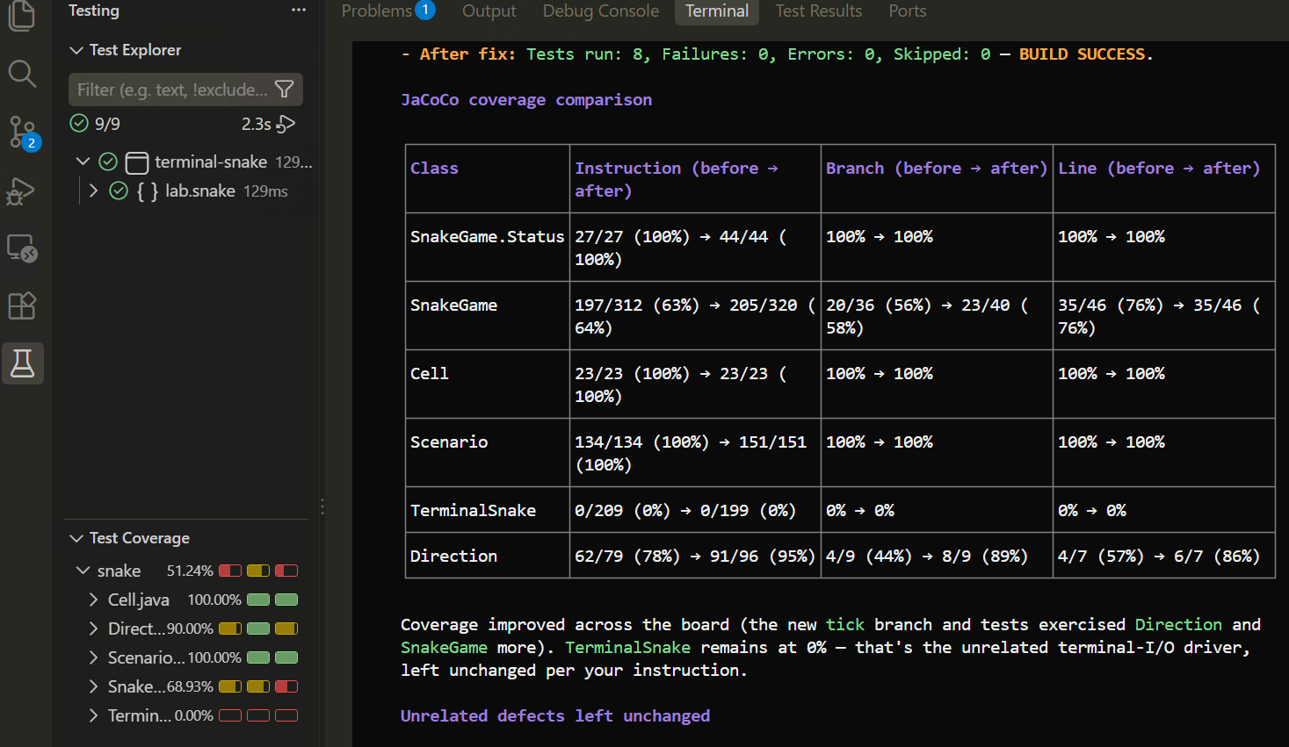
REGRESSION TEST
Fix the bug and rerun tests
Copy this prompt to OpenCode in Build Mode
Apply the fix. Run tests. Generate JaCoCo coverage and compare it with the baseline. Leave unrelated defects unchanged.
Notes:
T28 | Fix the cause and rerun tests
Source: Supplied W7 debugging and bug-report lecture slides; 2025 CS3343 BugReporting tutorial; executable Terminal Snake starter; official GitHub collaboration/Issue/review documentation. Local Java/Maven replay recorded; classroom OpenCode/dpsk and GUI screenshots pending.
Prior: Add the failing regression test first
Next: Verify nearby behaviour
[CAPTURE NEEDED]
Product/build: Record actual classroom VS Code Java extension, GitHub web UI and OpenCode/dpsk versions.
Starting state: Follow preceding pages on the specified branch and account.
Exact action already completed: Expect the regression test and all 6 original tests to pass. The replay should stay RUNNING at (1,2), length 4. Compare line and branch coverage. Inspect assertions and behaviour as well as the percentages.
Required visible region/text: Minimal repair, green tests, corrected replay and JaCoCo comparison
Callouts to add: File/path, active branch/account role, named control and decisive result.
Data to redact: Credentials, keys, endpoints, personal usernames/email and unnecessary local paths. Keep the student account and current branch identifiable without exposing personal data.

Slide 27
REGRESSION TEST
Play with LOOP and verify behaviour
Case | Required result
LOOP, A: departing tail | RUNNING; head=(1,2); length=4
LOOP, S: reversal ignored | Continue UP to (2,1)
Occupied non-tail cell | SELF; the head does not move
Food / ordinary movement | Grow and add 10 / keep length
Notes:
T29 | Verify nearby behaviour
Source: Supplied W7 debugging and bug-report lecture slides; 2025 CS3343 BugReporting tutorial; executable Terminal Snake starter; official GitHub collaboration/Issue/review documentation. Local Java/Maven replay recorded; classroom OpenCode/dpsk and GUI screenshots pending.
Prior: Fix the cause and rerun tests
Next: Commit and publish the fix

Slide 28
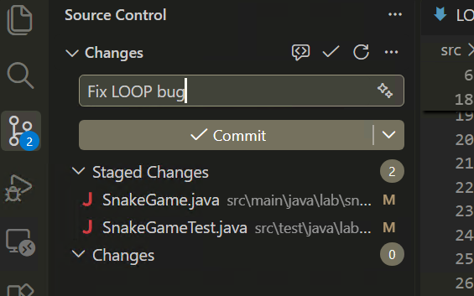
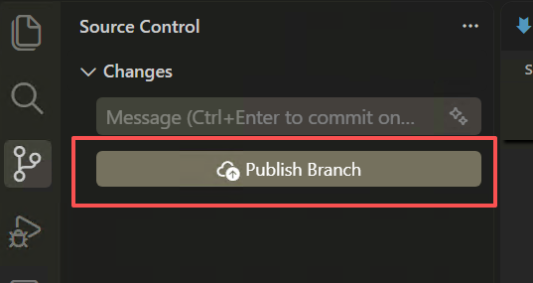
PREPARE THE PR
Commit and publish the fix
Source Control → inspect source and test diffs → stage with + → Commit “Fix LOOP bug” → Publish Branch.
Notes:
T30 | Commit and publish the fix
Source: Supplied W7 debugging and bug-report lecture slides; 2025 CS3343 BugReporting tutorial; executable Terminal Snake starter; official GitHub collaboration/Issue/review documentation. Local Java/Maven replay recorded; classroom OpenCode/dpsk and GUI screenshots pending.
Prior: Verify nearby behaviour
Next: Draft the PR description
[CAPTURE NEEDED]
Product/build: Record actual classroom VS Code Java extension, GitHub web UI and OpenCode/dpsk versions.
Starting state: Follow preceding pages on the specified branch and account.
Exact action already completed: Source Control → inspect source and test diffs → stage with + → Commit “Fix departing-tail collision” → Publish Branch. Confirm the new regression test is included. Do not commit target/ or opencode.json. Keep this branch focused on the LOOP Issue. Separate unrelated repairs before publishing.
Required visible region/text: Published fix/tail-collision with focused source and test changes
Callouts to add: File/path, active branch/account role, named control and decisive result.
Data to redact: Credentials, keys, endpoints, personal usernames/email and unnecessary local paths. Keep the student account and current branch identifiable without exposing personal data.

Slide 29
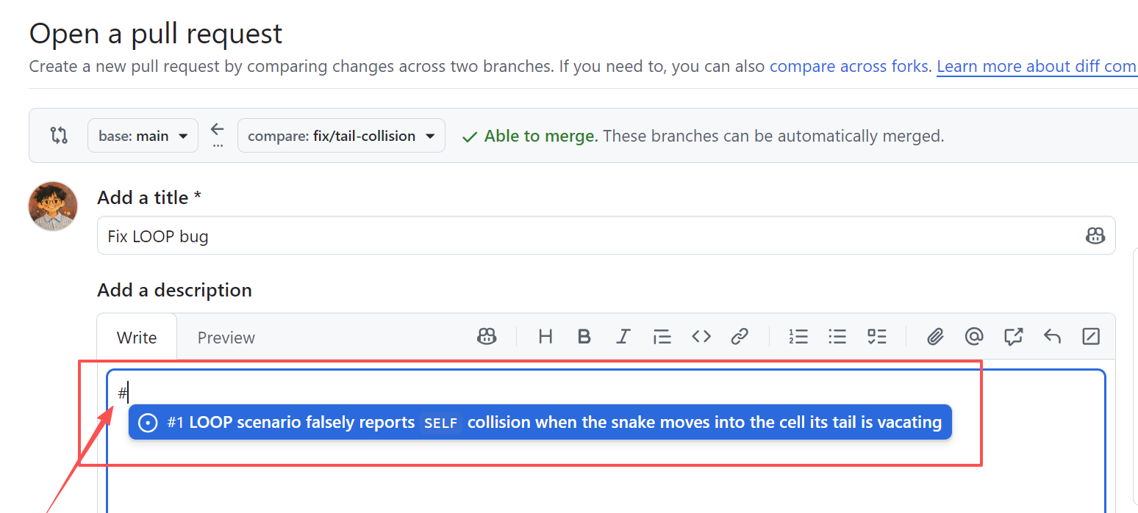
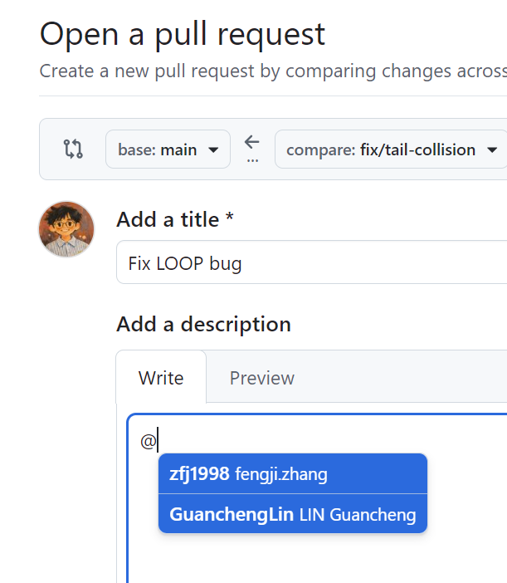
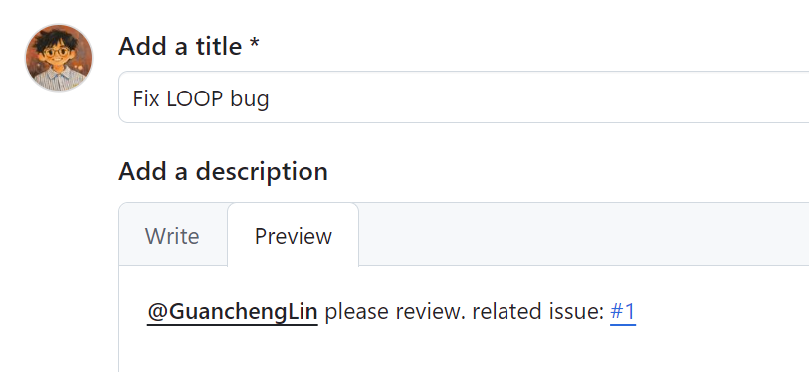
REVIEW THE FIX
Open the PR and request review
GitHub → Pull requests → New pull request. Base: main; compare: fix/tail-collision → Create pull request.
Use `#` in the description to cite the specific Issue
Use `@` in the description to include relevant project mates
Notes:
T32 | Open the PR and request review
Source: Supplied W7 debugging and bug-report lecture slides; 2025 CS3343 BugReporting tutorial; executable Terminal Snake starter; official GitHub collaboration/Issue/review documentation. Local Java/Maven replay recorded; classroom OpenCode/dpsk and GUI screenshots pending.
Prior: Draft the PR description
Next: What the assigned reviewer does
[CAPTURE NEEDED]
Product/build: Record actual classroom VS Code Java extension, GitHub web UI and OpenCode/dpsk versions.
Starting state: Follow preceding pages on the specified branch and account.
Exact action already completed: GitHub → Pull requests → New pull request. Base: main; compare: fix/tail-collision. Paste the checked title and description → Create pull request. PR sidebar → Reviewers → select the accepted collaborator. In the conversation, @mention them and ask them to check the tail rule and regression assertions. Requesting review is separate from @mention. If the collaborator is missing, check invitation acceptance and repo access.
Required visible region/text: PR to main, Closes #actual-number and requested reviewer
Callouts to add: File/path, active branch/account role, named control and decisive result.
Data to redact: Credentials, keys, endpoints, personal usernames/email and unnecessary local paths. Keep the student account and current branch identifiable without exposing personal data.

Slide 30
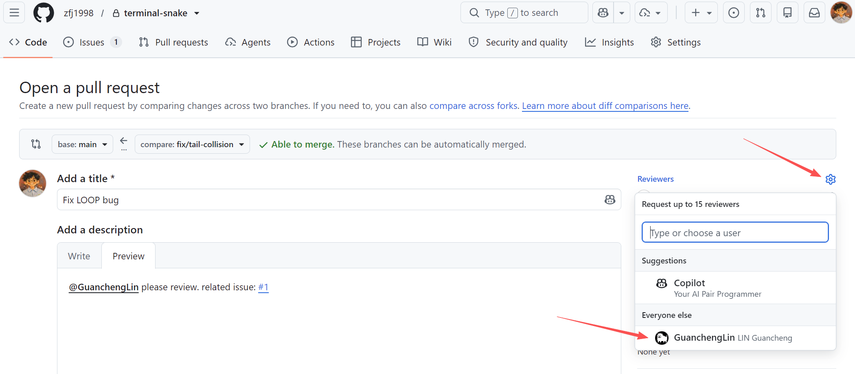
REVIEW THE FIX
Open the PR and request review
PR sidebar → Reviewers → select the accepted collaborator.
Notes:
T32 | Open the PR and request review
Source: Supplied W7 debugging and bug-report lecture slides; 2025 CS3343 BugReporting tutorial; executable Terminal Snake starter; official GitHub collaboration/Issue/review documentation. Local Java/Maven replay recorded; classroom OpenCode/dpsk and GUI screenshots pending.
Prior: Draft the PR description
Next: What the assigned reviewer does
[CAPTURE NEEDED]
Product/build: Record actual classroom VS Code Java extension, GitHub web UI and OpenCode/dpsk versions.
Starting state: Follow preceding pages on the specified branch and account.
Exact action already completed: GitHub → Pull requests → New pull request. Base: main; compare: fix/tail-collision. Paste the checked title and description → Create pull request. PR sidebar → Reviewers → select the accepted collaborator. In the conversation, @mention them and ask them to check the tail rule and regression assertions. Requesting review is separate from @mention. If the collaborator is missing, check invitation acceptance and repo access.
Required visible region/text: PR to main, Closes #actual-number and requested reviewer
Callouts to add: File/path, active branch/account role, named control and decisive result.
Data to redact: Credentials, keys, endpoints, personal usernames/email and unnecessary local paths. Keep the student account and current branch identifiable without exposing personal data.

Slide 31
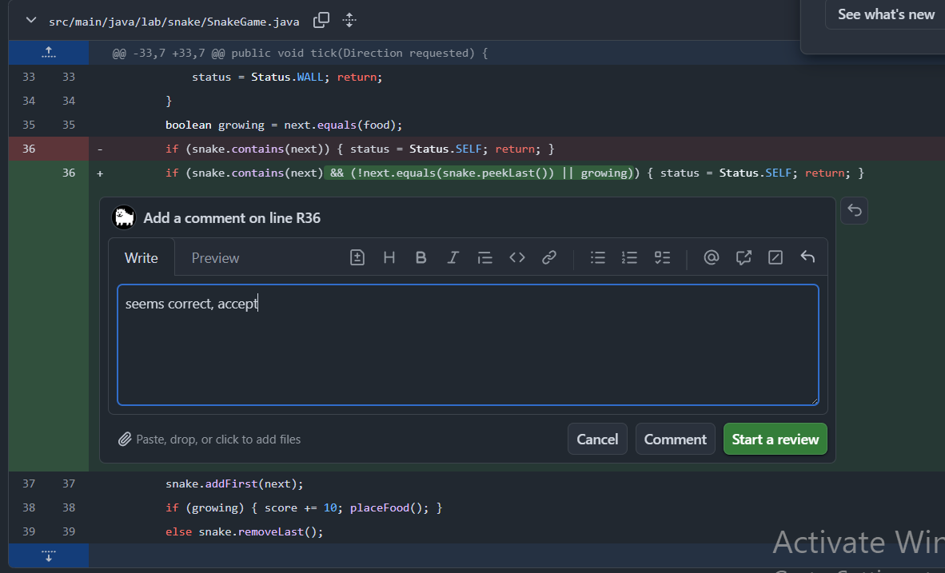
REVIEW THE FIX
What the assigned reviewer does
Reviewer: VS Code → Source Control → Git: Clone → paste the repo URL → Open. Click the branch name → select origin/fix/tail-collision (Fetch first if it is missing).
Testing → Run All Tests, or ask OpenCode to run tests. Replay LOOP.
GitHub PR → Files changed → hover the relevant line → blue + → write one specific observation or question → Submit review.
Notes:
T33 | What the assigned reviewer does
Source: Supplied W7 debugging and bug-report lecture slides; 2025 CS3343 BugReporting tutorial; executable Terminal Snake starter; official GitHub collaboration/Issue/review documentation. Local Java/Maven replay recorded; classroom OpenCode/dpsk and GUI screenshots pending.
Prior: Open the PR and request review
Next: Use AI to prepare a code review
[CAPTURE NEEDED]
Product/build: Record actual classroom VS Code Java extension, GitHub web UI and OpenCode/dpsk versions.
Starting state: Follow preceding pages on the specified branch and account.
Exact action already completed: Reviewer: VS Code → Ctrl+Shift+P → Git: Clone → paste the repo URL → Open. Click the branch name → select origin/fix/tail-collision (Fetch first if it is missing). Testing → Run All Tests, or ask OpenCode to run tests. Replay LOOP A. Confirm your local commit matches the latest PR commit. GitHub PR → Files changed → inspect the repair and assertions → Review changes → submit Comment, Request changes or Approve. This is the reviewer’s workflow; no second classroom folder is required.
Required visible region/text: Reviewer at the PR branch with test result and GitHub Files changed
Callouts to add: File/path, active branch/account role, named control and decisive result.
Data to redact: Credentials, keys, endpoints, personal usernames/email and unnecessary local paths. Keep the student account and current branch identifiable without exposing personal data.

Slide 32
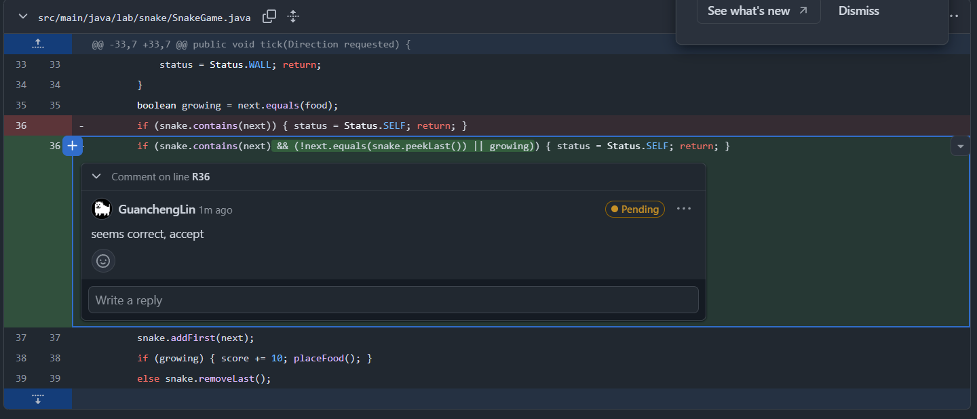
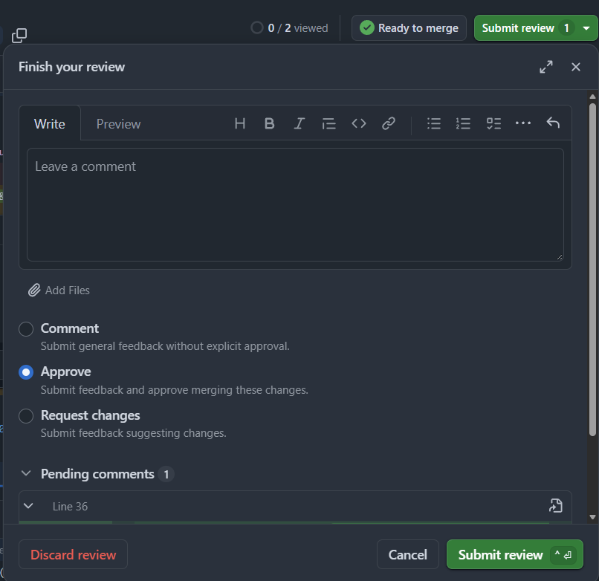
REVIEW THE FIX
What the assigned reviewer does
GitHub PR → Files changed → hover the relevant line → blue + → write one specific observation or question → Submit review.
Notes:
T33 | What the assigned reviewer does
Source: Supplied W7 debugging and bug-report lecture slides; 2025 CS3343 BugReporting tutorial; executable Terminal Snake starter; official GitHub collaboration/Issue/review documentation. Local Java/Maven replay recorded; classroom OpenCode/dpsk and GUI screenshots pending.
Prior: Open the PR and request review
Next: Use AI to prepare a code review
[CAPTURE NEEDED]
Product/build: Record actual classroom VS Code Java extension, GitHub web UI and OpenCode/dpsk versions.
Starting state: Follow preceding pages on the specified branch and account.
Exact action already completed: Reviewer: VS Code → Ctrl+Shift+P → Git: Clone → paste the repo URL → Open. Click the branch name → select origin/fix/tail-collision (Fetch first if it is missing). Testing → Run All Tests, or ask OpenCode to run tests. Replay LOOP A. Confirm your local commit matches the latest PR commit. GitHub PR → Files changed → inspect the repair and assertions → Review changes → submit Comment, Request changes or Approve. This is the reviewer’s workflow; no second classroom folder is required.
Required visible region/text: Reviewer at the PR branch with test result and GitHub Files changed
Callouts to add: File/path, active branch/account role, named control and decisive result.
Data to redact: Credentials, keys, endpoints, personal usernames/email and unnecessary local paths. Keep the student account and current branch identifiable without exposing personal data.

Slide 33
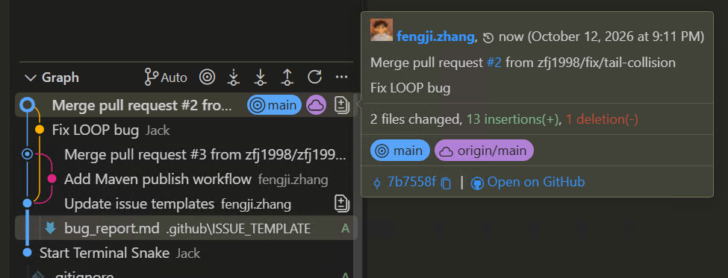
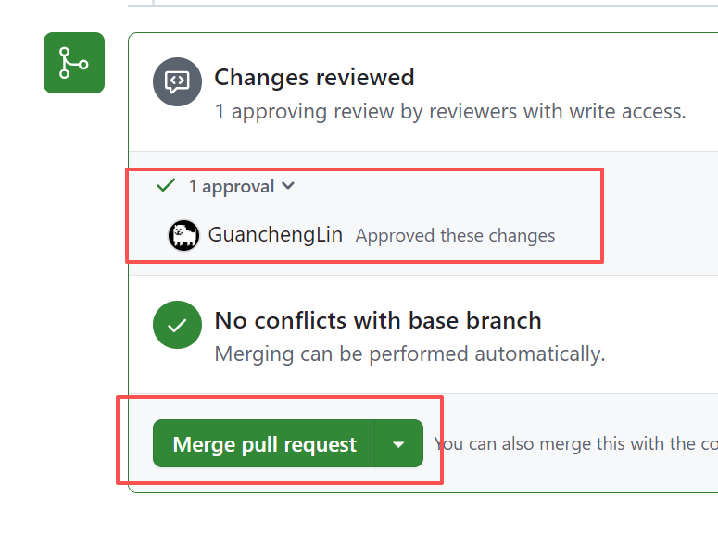
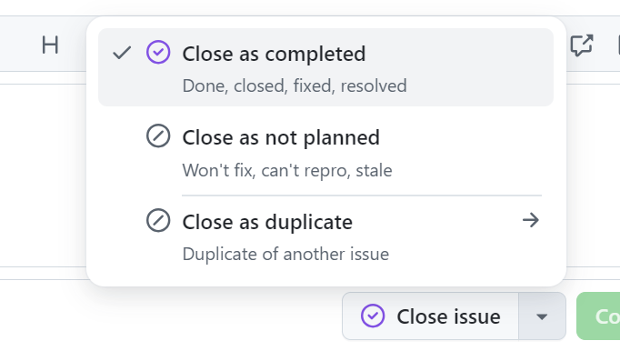
FINISH THE ISSUE
Approve, merge and pull main, Close Issue
Owner: merge the reviewed PR into main on GitHub. Closes #NUMBER in the PR body closes the linked Issue when merged into the default branch.
Author: VS Code → switch to main → Source Control … → Pull. Run tests and the reproduction again. Check PR Merged, Issue Closed and clean local main.
Notes:
T37 | Approve, merge and pull main
Source: Supplied W7 debugging and bug-report lecture slides; 2025 CS3343 BugReporting tutorial; executable Terminal Snake starter; official GitHub collaboration/Issue/review documentation. Local Java/Maven replay recorded; classroom OpenCode/dpsk and GUI screenshots pending.
Prior: Check and respond to feedback
Next: After class: debug PICNIC
[CAPTURE NEEDED]
Product/build: Record actual classroom VS Code Java extension, GitHub web UI and OpenCode/dpsk versions.
Starting state: Follow preceding pages on the specified branch and account.
Exact action already completed: Reviewer: inspect the latest diff and results → Review changes → Approve → Submit review. The author cannot approve their own PR. Owner: merge the reviewed PR into main on GitHub. Closes #NUMBER in the PR body closes the linked Issue when merged into the default branch. Author: VS Code → switch to main → Source Control … → Pull. Run tests and the reproduction again. Check PR Merged, Issue Closed and clean local main.
Required visible region/text: Submitted approval, merged PR, closed Issue and updated local main
Callouts to add: File/path, active branch/account role, named control and decisive result.
Data to redact: Credentials, keys, endpoints, personal usernames/email and unnecessary local paths. Keep the student account and current branch identifiable without exposing personal data.

Slide 34
Exercise: debug Wall and PICNIC
Hints for the PICNIC bug | What to investigate
Choose 4 PICNIC; enter D | Food is eaten: length=4, score=10
Enter R to restart | Required: original body, RUNNING and score=0
Observe the actual result | Does the new round retain the old score?
Use the same debugging route | Report → hypothesis → failing test → fix → PR
Create a separate Issue and branch from updated main. Use OpenCode to investigate and verify the repair.
WALL is another optional exercise: try to identify the bug yourself and fix with the standard bug reporting and PR pipeline.
Notes:
T38 | After class: debug PICNIC
Source: Supplied W7 debugging and bug-report lecture slides; 2025 CS3343 BugReporting tutorial; executable Terminal Snake starter; official GitHub collaboration/Issue/review documentation. Local Java/Maven replay recorded; classroom OpenCode/dpsk and GUI screenshots pending.
Prior: Approve, merge and pull main
Next: What a completed fix contains

